Slide 1

Cytology for your derm cases
Prepared by the Canadian Academy of Veterinary Dermatology

Slide 2
The skin is a unique, very accessible organ
Why do skin cytology?
Skin cytology is a very high-yield procedure for patients with skin disease
It tells us more about what is going on with the skin, more quickly, compared to most other diagnostic tests.
It is inexpensive and easy to perform. Nearly all patients with skin disease, and particularly those with skin lesions, should have this test performed.
It is also very useful for monitoring therapy.
And clients love getting nearly instant results!

Slide 3
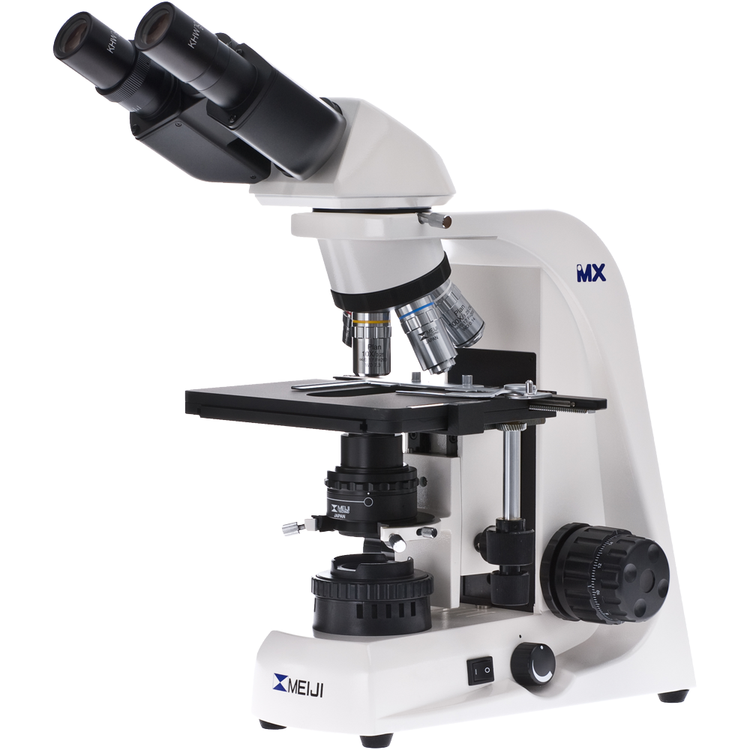
It’s true!
As with anything else, there are many different ways to collect and process samples for cytology. We have put together some tried and true methods to help ensure your success.

Slide 4
Cytology can be collected by direct and tape techniques
How is cytology collected?
For the direct techniques, material can be collected from the surface of the skin as follows
impressions
swabbing
scraping

Slide 5
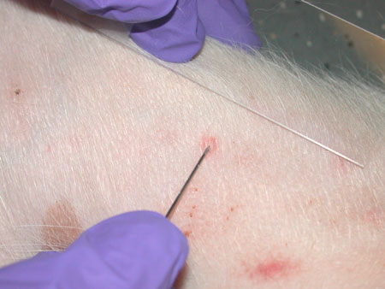
Impressions
directly press the slide on the skin several times
greasy and moist lesions work best for impression smears
you can lance a pustule with a sterile needle, or lift a crust
A lifted crust can even be used as a stamp!

Slide 6
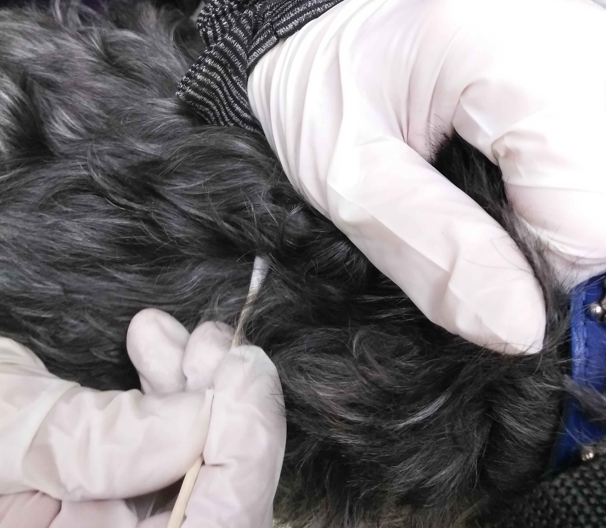
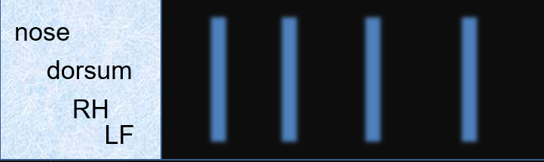
Swabbing
swab the affected area vigorously (just like colouring with a crayon) then gently roll swab onto a slide
you can save time by putting several samples on one slide, so there is only one slide to process and read!

Slide 7
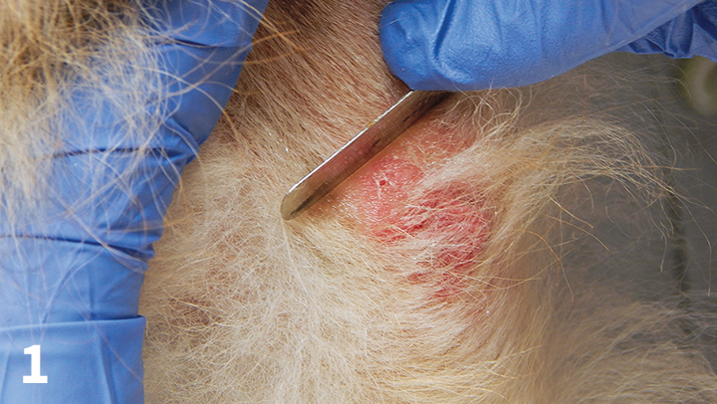
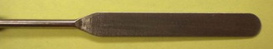
Scraping
collect surface debris from the skin, using either a dulled scalpel blade or spatula, and smear the material onto a slide like buttering bread
scrapings for cytology are superficial (do not draw blood) and no oil is used

Slide 8
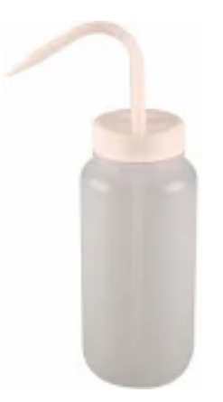
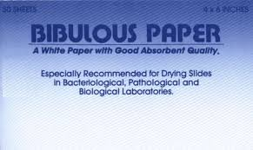
How do you stain your cytology slides?
As mentioned previously, there are MANY ways to do things, and that includes how
to process your direct smears!
Here’s what works for us…
Fixative
Eosin
Thiazine
Rinse

Slide 9
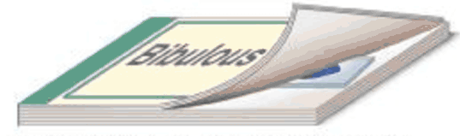
Samples from dry, waxy or greasy (not moist) skin should be heat-fixed to keep your sample in place while it is processed. After heat fixing, wipe the back of the slide to remove any possible soot left behind. All direct techniques are stained with Diff Quick (fixative + 2 stains, rinse, dry, coverslip) and examined under the the microscope for evaluation.
Dip slide in fixative for a slow count of 10, then remove from fixative and allow excess to drain into fixative container.
Dip slide into final purple stain for a slow count of 20. Doubling the time in the purple stain will allow for better saturation of things like yeast, mast cells and acantholytic keratinocytes.
Dip slide into pink eosin stain for a slow count of 10, then remove and allow excess to drain into eosin stain container.
The slide is then removed from the stain. Allow the excess to drain into the purple stain container and thoroughly rinse both sides of the slide with a gentle stream of tap water. When you think you are done, give it one more rinse!
10 wobbles back and forth
let excess run
off into vial
10 wobbles back and forth
let excess run
off into vial
20 wobbles back and forth
let excess run
off into vial
Blot dry using a clean section of bibulous paper. Do not rub your sample, simply press down on a flat surface. Apply a drop of oil followed by a cover slip and your sample is ready to be evaluated. * Using long 22mm x 40mm coverslips allows for a larger area to be read easily, which is really handy if you have more than one sample rolled onto your slide.
Notes:
Almost everyone you speak to has a different method of staining slide with Diff-Quik.
Here`s what we do in the dermatology service at OVC:
Heat fix if sample is waxy or greasy
Remove any soot from back of slide
Dip in fixative for slow count of 10
Let excess drain back into vial
Dip in first stain (pink eosin stain) for slow count of 10
Let excess drain back into vial
Dip in final purple stain for slow count of 20
Let excess drain back into vial
Rinse both sides of slide thoroughly with gentle stream of water
Shake excess water from slide and blot dry with bibulous paper
Apply one drop of immersion oil, then apply coverslip
*** make sure there is only one coverslip – if there are two stuck together, you will be able to see clearly at low power and high dry, but will be driven insane trying to focus on oil immersion lens ***
Be sure to change your stains at least once every 2 weeks or you will have stain precipitants on your samples which can be difficult to distinguish from bacteria on cytology.
As well, be sure to take your sample on the sample side of the slide – it will be impossible to focus when the sample is on the other side!

Slide 10
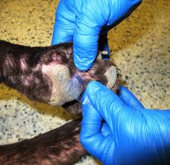
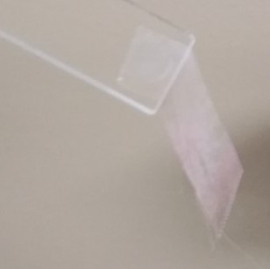
*For best results, you must use clear tape
How do you collect cytology with tape?
a 3-5 cm piece of clear tape is pressed onto the skin several times, sticky side down. Be sure to handle to the tape on one end only. This is called “the sacrificial finger print end”.
the edge of the finger print end of your tape sample is pressed, sticky side down, on the non-frosted end of a slide to hold it in place. The rest of tape is hanging freely from the end.

Slide 11
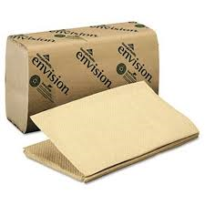
What about staining tape samples?
There are also MANY ways to process
tape samples!
Here’s what works for us…
Fixative
Eosin
Thiazine
Rinse

Slide 12

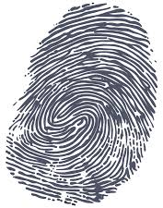
* The fixative is not used for acetate tape preps.
The freely hanging tape is then immersed in the purple, final stain of Diff Quick for a slow count of 20. Doubling the time in the purple stain will allow for better saturation of things like yeast, mast cells and acantholytic keratinocytes.
The freely hanging tape is immersed in the pink eosin stain for a slow count of 10. Remove the tape from the stain and allow the excess to run off into the eosin stain container.
The tape is then removed from the stain. Allow the excess to drain into the purple stain container and thoroughly rinse both sides of the tape with a gentle stream of tap water. When you think you are done, give it one more rinse!
10 wobbles back and forth
let excess run
off into vial
20 wobbles back and forth
let excess run
off into vial
Using the sacrificial finger print end of your sample, remove the tape and lay it sticky side down, on to your slide, with the finger print end towards the frosted end of the slide. This allows you to keep track of where your finger print is, so don’t end up evaluating your own cytology!
😋
Notes:
Almost everyone you speak to has a different method of staining slide with Diff-Quik.
Here`s what we do in the dermatology service at OVC:
Heat fix if sample is waxy or greasy
Remove any soot from back of slide
Dip in fixative for slow count of 10
Let excess drain back into vial
Dip in first stain (pink eosin stain) for slow count of 10
Let excess drain back into vial
Dip in final purple stain for slow count of 20
Let excess drain back into vial
Rinse both sides of slide thoroughly with gentle stream of water
Shake excess water from slide and blot dry with bibulous paper
Apply one drop of immersion oil, then apply coverslip
*** make sure there is only one coverslip – if there are two stuck together, you will be able to see clearly at low power and high dry, but will be driven insane trying to focus on oil immersion lens ***
Be sure to change your stains at least once every 2 weeks or you will have stain precipitants on your samples which can be difficult to distinguish from bacteria on cytology.
As well, be sure to take your sample on the sample side of the slide – it will be impossible to focus when the sample is on the other side!

Slide 13
Lay the slide down on a paper towel; fold the paper towel over on top of the slide and press to blot and remove any excess fluid. Apply pressure and move from left to right to press out extra fluid and any trapped air. Refold paper towel to a dry section and perform a second time.
Apply a drop of immersion oil followed by a cover slip and your sample is ready to be evaluated. * Using long 22mm x 40mm coverslips allows for a larger area to be read easily.
** Reading tape samples takes practice! It is a very busy sample, but extra rinsing, extra blotting, and application of oil and coverslip will give you your clearest image.
This technique allows for evaluation of inflammatory cells, bacteria, yeast, and other fungal organisms.

Slide 14
Why use 4 different techniques?
Some of it depends on personal preference - many practitioners will always use one technique.
However, each one is best for certain situations and has advantages over the other techniques
Fixative

Slide 15
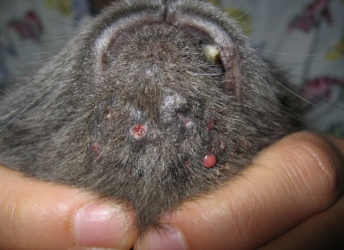
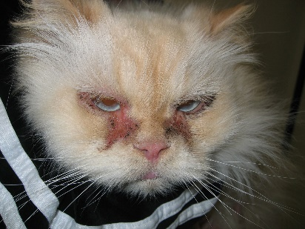
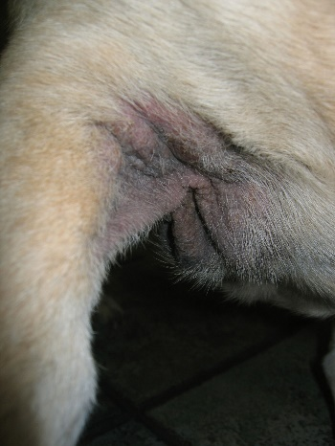
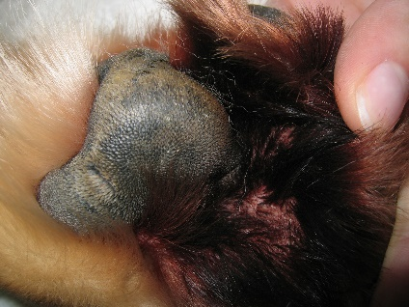
When to use what
Not good for
dry or minimally exudative
small areas (e.g. nail folds)
awkward areas (e.g. interdigital)
Impression
Works well for
moist, exudative lesions
pustules (open with needle)
crusts (peel crust, touch skin or use crust as a stamp)
very greasy skin
draining lesions
spaces)
Works well for
moist, greasy, exudative lesions
small areas (e.g.. face & lip folds, nail beds)
ears
Not good for
dry or minimally exudative lesions
Swab
Works well for
large greasy lesions
Dry scraping
Not good for
sensitive areas
rambunctious patients
near eyes
Works well for
greasy or dry skin
minimally abnormal skin
awkward areas
small areas
sensitive areas
Not good for
purulent lesions
moist skin
Tape

Slide 16


Assess
Cytology samples are examined under lowest power lens first, gradually move up through higher objective lenses, and finish examining under oil immersion. Examining under oil immersion allows you to be certain that no small organisms were missed.

Slide 17
That’s it!
If you would like a hard copy, you can find a handout on the CAVD website under IN-CLINIC TOOLS, along with other helpful items
https://www.cavd.ca
P.S. Don’t forget to like us on Facebook!

